Slide 1
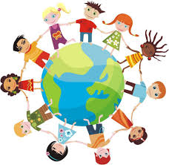
™
Massage in Schools Programme
MISP
Vision of Nurturing Touch for all Children of the World
Presentation given by: ____________________________

Slide 2
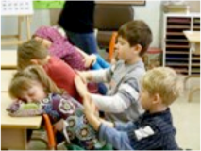
MISP
Massage In Schools Program
MISA
Massage In Schools Association

Slide 3
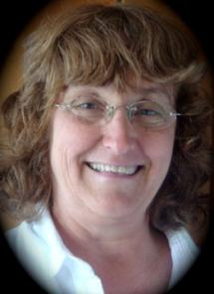
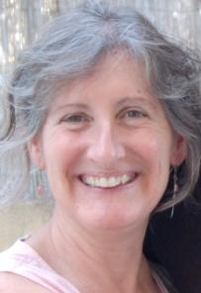
Co-Founders
Mia Elmsäter Sylvie Hétu
Sweden Canada

Slide 4
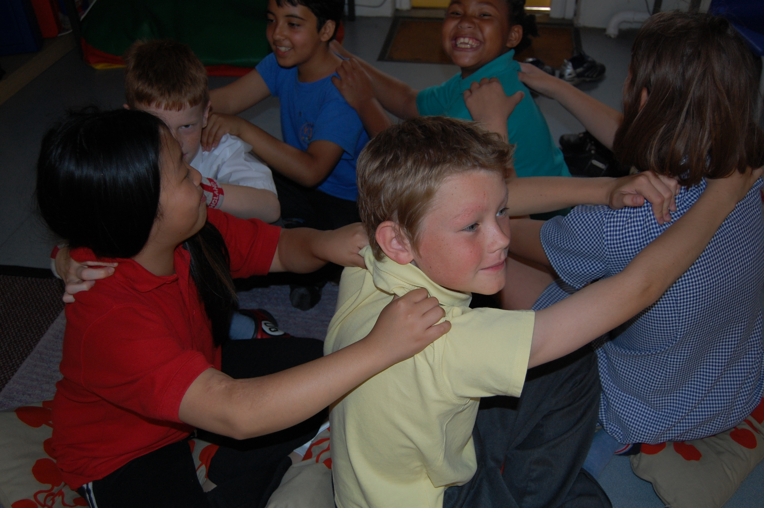
MISP Vision
The vision of the Massage In Schools Programme is that every child experiences positive and nurturing touch every day …
everywhere in the world.

Slide 5
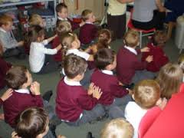
Foundations of the MISP:
Created in the mid 90’s by the co-founders answering requests from schools in Sweden and Canada
Established in 2000 following a request from UK colleagues for an official massage in schools programme
Designed for children 4 to 12 years old

Slide 6
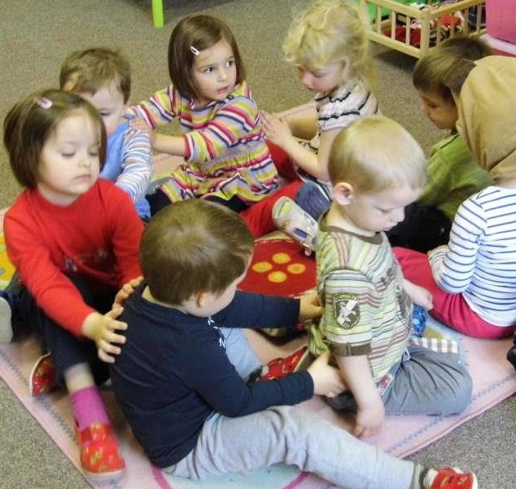
Characteristics of the MISP:
World-wide recognized professional programme
Positive touch for children
Enhance concentration and learning memory
A fully clothed approach
Child to child massage routine
Entire routine takes less than 15 mins
Effectiveness

Slide 7
The MISP is present in nearly
40 countries

Slide 8
Where in the World is the MISP??
Argentina, Australia, Belgium, Canada, Chile, China, Czech Republic, Cyprus, England, France, Germany, Guadeloupe, Hong Kong, India, Indonesia, Ireland, Israel, Italy, Japan, Malaysia, Netherlands, New Zealand, Northern Ireland, Portugal, Puerto Rico, Scotland, Spain, South Africa, Singapore, South Korea, Sweden, Switzerland, Taiwan, USA, Venezuela, Wales

Slide 9
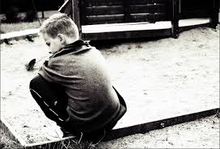
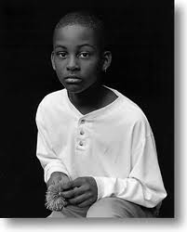
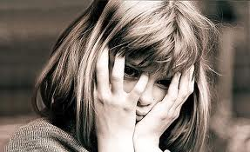
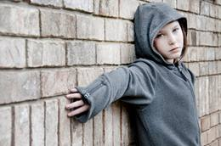
Why do we need the MISP?
More and more children suffer

Slide 10
Bullying and Violence a threat for all children

Slide 11
Bullying Statistics Globally
An estimated 200 million children are bullied every year, globally.
Children as young as 3 years of age are being bullied
Of the children with anxiety disorders, 1 out of 3 have been bullied
A new review of studies from 15 countries found a connection between bullying, being bullied and suicide
Cyber bullying is the newest and fastest growing form of bullying

Slide 12
The MISP helps reduce isolation

Slide 13
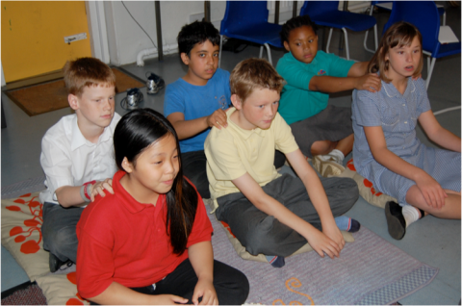
Three Main Aspects of MISP
Child to child massage routine
Touch and Movement for learning
MISP within families

Slide 14
MISP helps to develop Respect and Gratitude￼

Slide 15
Weather Massage

Slide 16
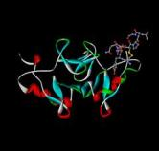
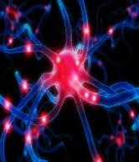
Hormones and Neuro-chemicals are influenced by the practice of the MISP
Oxytocin is increased
Cortisol is reduced

Slide 17
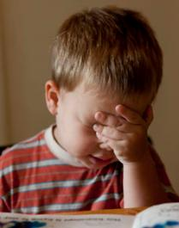
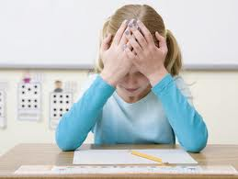
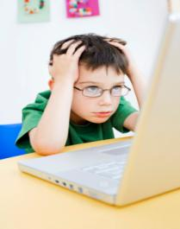
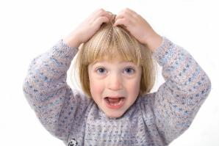
Remember…

Slide 18
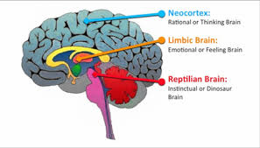
Influence of MISP on the Brain

Slide 19
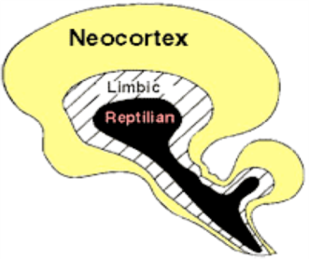
MISP has a direct influence on the limbic system
Calming down the reptilian brain
Learning and Concentration can then start
to happen in the neo-cortex

Slide 20
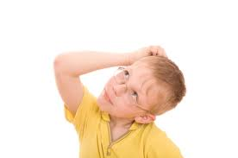
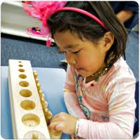
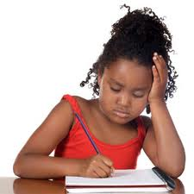
With MISP children are able to concentrate better

Slide 21
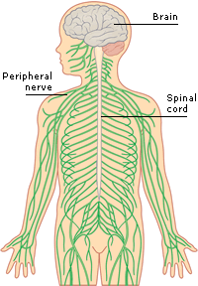
Nervous System
MISP balances the parasympathetic and sympathetic parts of the nervous system.

Slide 22
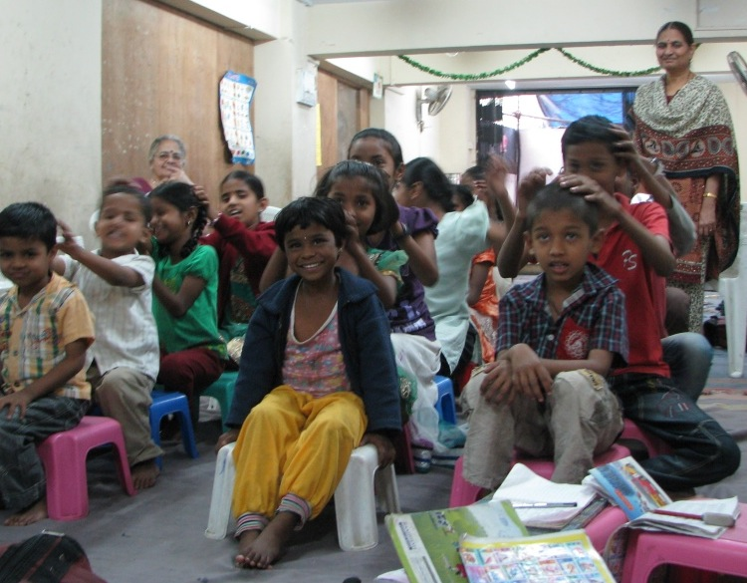
Benefits of the MISP
Children…
Teachers…
Classroom…
Entire school…
Parents & family…

Slide 23
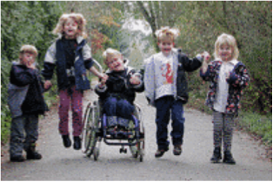
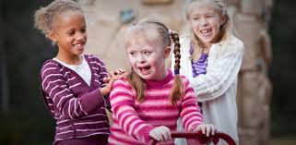
Social Integration
The goal of MISP is that all children feel they belong to a group, that they are loved and that they all have the same opportunities for well-being.
That includes children with special/additional needs.

Slide 24
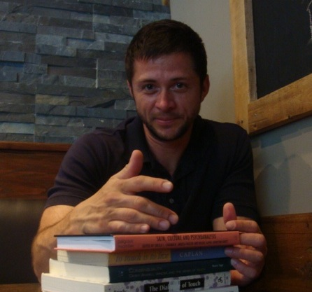
MISP is supported by research that can be found on our international website

Slide 25
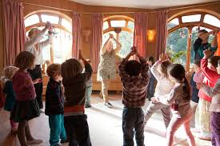
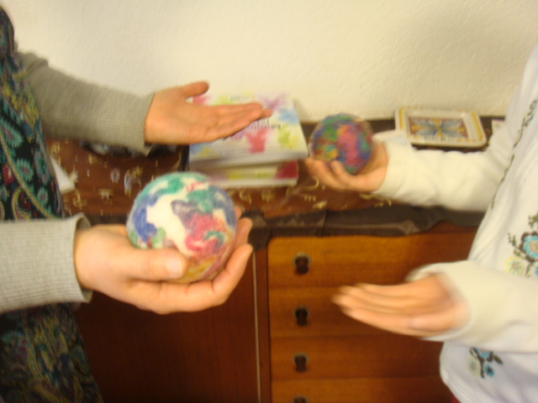
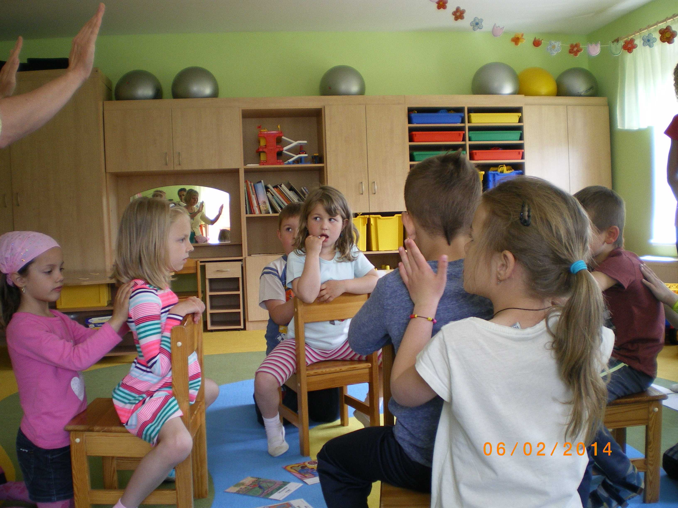
MISP Instructors are qualified to: *implement the MISP routine in schools/playgroup centres *implement MISP with children 4-12 years old *conduct family courses *offer workshops: Touch and Movement for learning

Slide 26
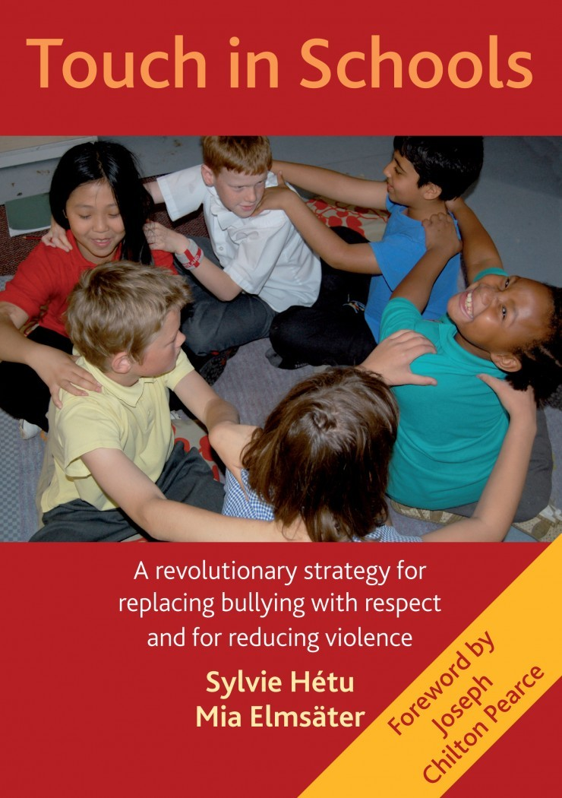
For more Information:
www.massageinschools.com
and

Slide 27
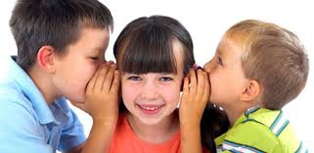
Children’s Quotes
“Massage makes me
feel special”
“I love MISP because
I have more friends”
“This is the best thing I have done in school”

Slide 28
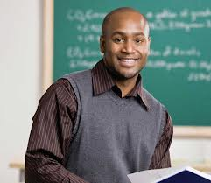
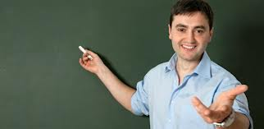
Quotes from Teachers
“The first thing I noticed when children came into my classroom and already knew the
massage is that they were more respectful
to their classmates and to me”
“I’ve noticed changes in how the children show
consideration, and share and resolve conflicts”
“After the morning massage,
I can actually do my job
and teach”

Slide 29
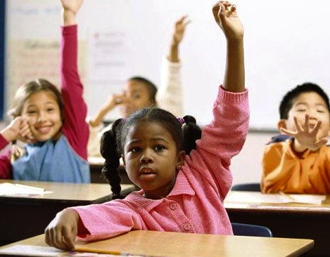
Questions and Reflections

Slide 30
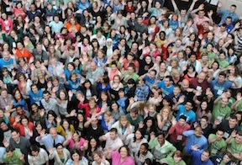
“When we dream, it is only a dream. When we dream together, it is no longer a dream, but the beginning of reality.”
“When we dream,
it is only a dream.
When we dream together,
it is no longer a dream,
but the beginning of reality.”

